Slide 1

WEST WITTERING NEIGHBOURHOOD PLAN
VISIONING WORKSHOP
14th JUNE 2016
Rowena Tyler
Allison Keech

Slide 2
INTRODUCTION – Allison Keech MRTPI
Allison has over 25 years experience in planning and most recently worked for a planning consultancy based in Tunbridge Wells. She worked on the Burgess Hill Neighbourhood Plan which is now a made Plan. She is a freelance Planner and is working with AirS on 10 neighbourhood plans.

Slide 3
AN OVERVIEW OF WEST WITTERING
Rural community profile for West Wittering 2013 . This profile brings together up to date quantitative data for the area with each of the sections showing data for West Wittering, comparing it with other areas (local authority and national averages).
Settlement Capacity Profiles 2013. This assessed the key characteristics of the different settlements and the capacity and potential of settlements to accommodate future growth.
West Wittering Conservation Area Character Appraisal & Management Proposals (January 2006, updated March 2012).
The Landscape Capacity Study 2009, identified 6 Landscape Character Areas surrounding the village.
The West Wittering Village Design Statement 2006 gives detailed design guidance based on the distinctive character of the village.

Slide 4
AN OVERVIEW OF WEST WITTERING
West Wittering is a relatively compact village, set slightly inland at the south western end of the Manhood Peninsula. Open fields surround the village together with two caravan parks to the north. The village straddles Rookwood Lane/Cakeham Road (B2179). The historic village core is centred on Pound Road with spacious plots curving round to St Peter and Paul Church in the south, an important focal point. Sports fields are located adjacent to the north and east of the village. The open spaces, mature trees and spacious plots contribute to the rural character.
Community Facilities: Convenience Stores (2), Primary school, Village hall, Pub, Outdoor Recreation Areas (2).
Accessibility: 2 regular daytime bus service. Nearest rail station, Chichester, about 10 km. Village has reasonable road access to Chichester and the A27.
About 2 km from the business centre of East Wittering.

Slide 5
AN OVERVIEW OF WEST WITTERING
Development Constraints
Chichester Harbour AONB covers land to the north and west of the village. A Conservation Area covers the centre of the village. Chichester Harbour SAC, Chichester and Langstone Harbours SPA and Ramsar Site are immediately to the south and west of the village. SSSI (Bracklesham Bay) and SNCI (West Wittering Beach) are located to the south of the village. Areas of tidal flood risk (Flood Zones 2 and 3) are to south and west of the village. Grade 2 Agricultural Land is to the north and east of the village.
Infrastructure & Environmental Capacity Constraints
Potentially high impact of development and recreational disturbance on Chichester
Harbour. Sites would connect to Sidlesham WwTW (which has physical capacity for around 900 homes). Some traffic issues at peak times and during the summer months due to visitors to West Wittering Beach.

Slide 6
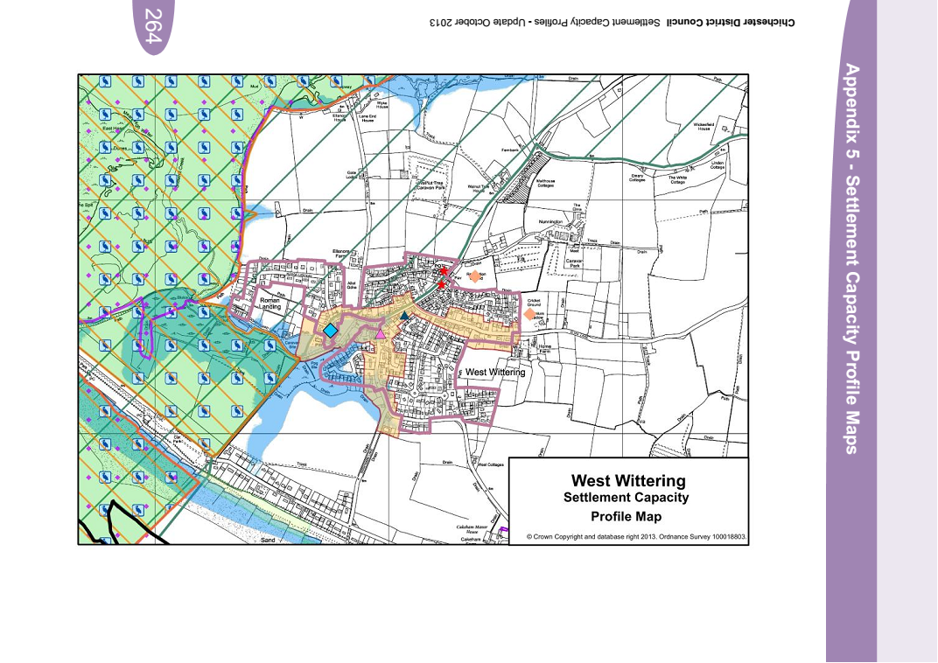

Slide 7
PLANNING POLICIES AND BACKGROUND STUDIES
Chichester Local Plan: Key Policies 2014-2029 adopted 2015
Policy 2 Development Strategy and Settlement Hierarchy
Service Villages – West Wittering
Provision will be made for the following: a. Small scale housing developments, b. Local community facilities, and c. Small scale employment, tourism or leisure proposals
Policy 5: Parish Housing Sites 2012- 2029
West Wittering – 50

Slide 8
VISION STATEMENTS
1. Are long term, for example looking forward 15-20 years, or the period that is covered by the Local Plan.
2. Are strategic, setting out a broad picture of your aspirations for your neighbourhood but will not include lots of details.
3. Describe what you want your neighbourhood to look like, so people can form an image of the homes, businesses, shops, community facilities and open space it will contain.
4. Consider what land use and development challenges will need to be addressed over the period covered by your Neighbourhood Plan. http://planninghelp.cpre.org.uk

Slide 9
EXAMPLES OF VISION STATEMENTS
‘To enhance Birdham as a beautiful harbour-side Parish with a close, supportive community at its heart, and to promote a sustainable thriving economy with a robust infrastructure and maintain the Area of Outstanding Natural Beauty, ecology and character of the harbour, canal and its rural and agricultural surroundings’.
‘In fifteen years’ time (2029) Fishbourne will be recognised as a vibrant, sustainable community which offers a safe and pleasant environment in which to live and work and which has met its indicative target for new housing while successfully maintaining its separate identity as a village and conserving and enhancing the character of its historic fabric and environment. It will continue to offer a wide range of physical and cultural activities so that its residents can enjoy a healthy and rounded lifestyle without the need to travel by car. To achieve all this, its residents will increasingly have experienced involvement in the decision-making process’

Slide 10
EXAMPLES OF OBJECTIVES
Objectives are more specific and set out what the Neighbourhood Plan aims to achieve. Look at each part of the vision and decide what needs to be done to achieve it. Examples include: a. Conserve and enhance important ecological sites and links, including hedgerows, ditches and key species in these habitats. b. To provide new and diverse leisure and recreational activities in order to promote healthy and crime-free lifestyles, particularly for youngsters. c. Accommodate sustainable housing development in accordance with the Chichester Local Plan and ensure that the development of sites is appropriate for this rural location.

Slide 11
STRENGTHS, WEAKNESSES, OPPORTUNITIES AND CHALLENGES (SWOC)
To look at a SWOC for each of the focus groups: a. Business & Employment b. Communication & Marketing c. Heritage & Environment d. Housing, Community & Infrastructure

